Slide 1
Text-Based Emotion Detection
By: Vishv Patel(17BCP039)
Mentor: Dr. SantoshKumar Bharti

Slide 2
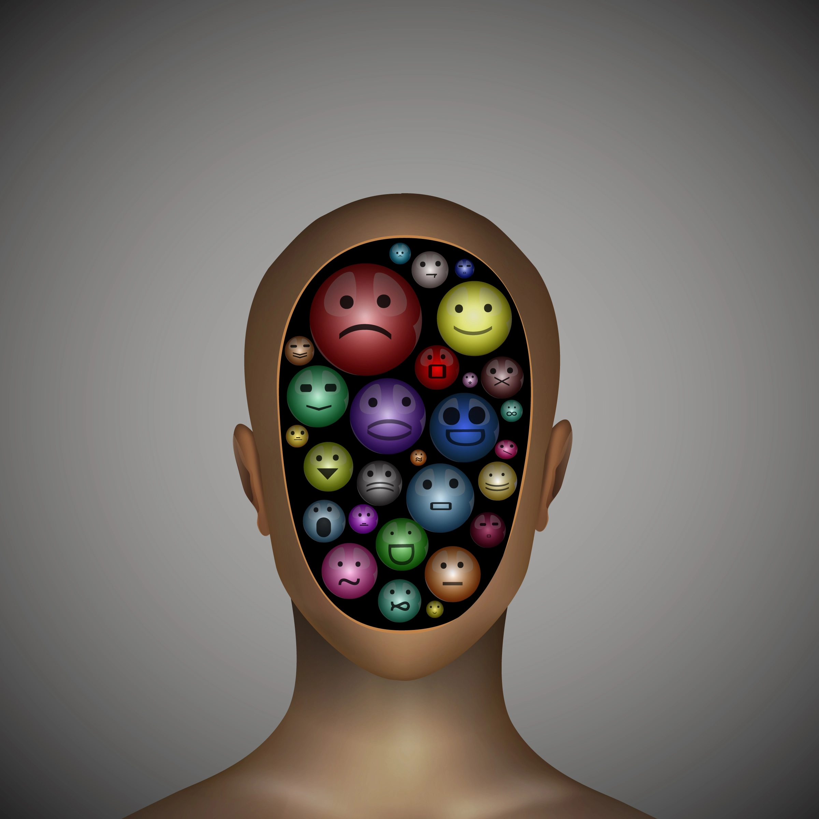
Emotion
In psychology, emotion is often defined as a complex state of feeling that results in physical and psychological changes that influence thought and behavior.

Slide 3
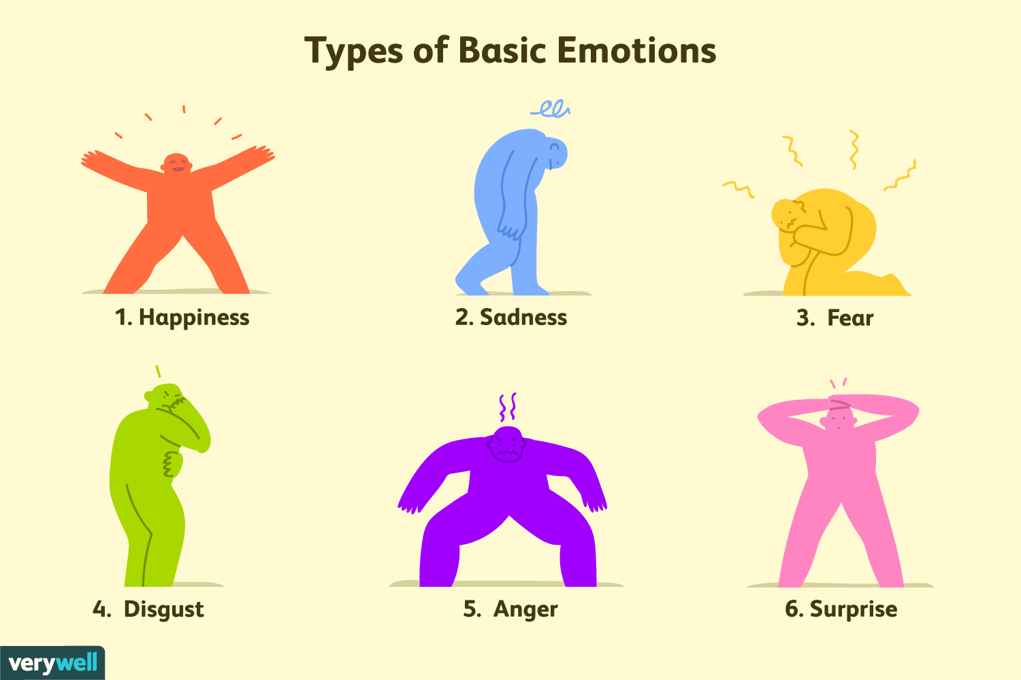
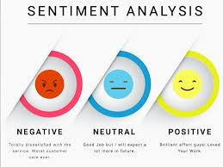

Beyond Sentiment

Slide 4
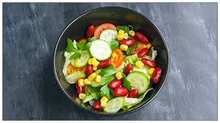
Tasteless

Slide 5

Introduction
MOTIVATION
Social Media and Entertainment
Marketing, Business potentials
Human-machine interaction

Slide 6

Introduction
GOALS
Detecting feelings based on expression in Text
Affective Computing

Slide 7
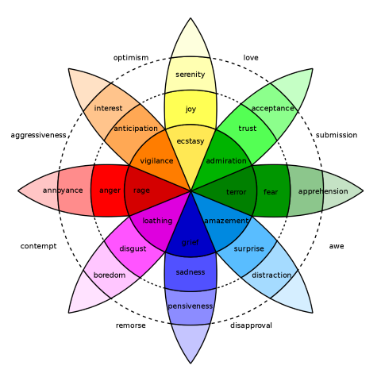
Emotions
Happy
Surprise
Disgust
Sad
Fear
Anger

Slide 8
Datasets
Dataset | Granularity | No. of Emotions | Size | Description
ISEAR | Sentences | 7 emotions | 7666 | Studied in 37 countries
WASSA | Tweets | 4 emotions | 4334 | Tweets
Emotion-stimulus | Dialogs | 7 emotions | 2500 | -

Slide 9
Literature Survey
Key features:
Word embedding → Quantifying semantic similarities between words[4]
Lexicon → Static Dictionary[4]
Corpus → Collection of text in single language or multiple languages[6][7]

Slide 10
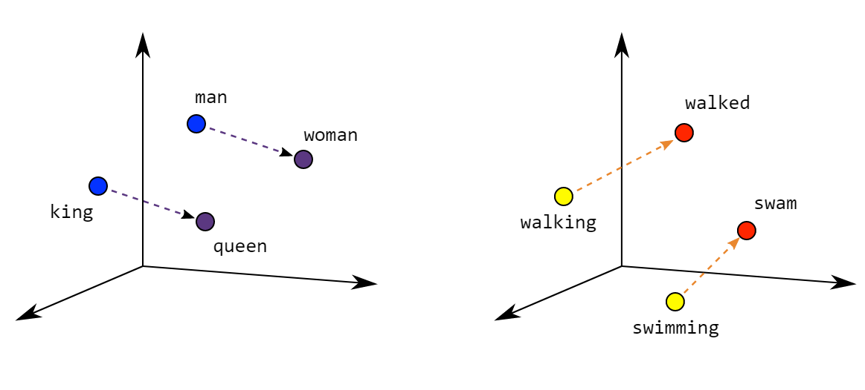
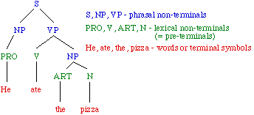
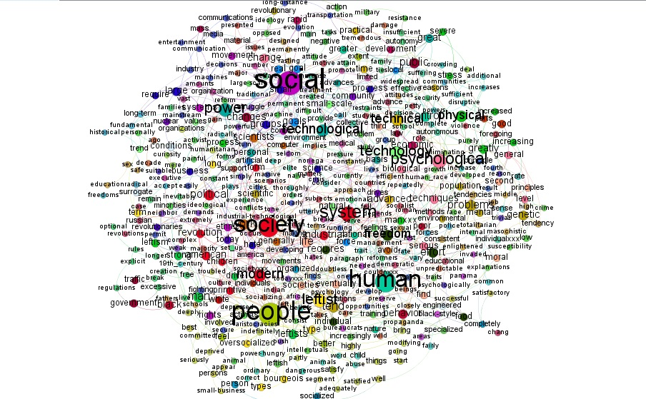
Word-embedding
Lexicon
Corpus

Slide 11
Literature Survey
Other features:
Keywords → Related to specific emotions[3][5]
Emojis → A facial expressions in form of icon
Polarity words → Negation of sentences(Keywords)
Punctuations → Separation of sentences and clarifying the meaning[1]
Structure of sentences

Slide 12
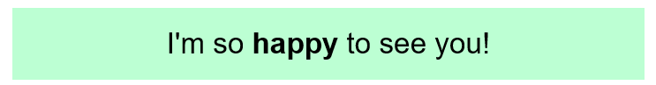
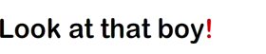
I’m not happy today.
not long till the blind spots exhibition! #jacksonpollock @tateliverpool 😍
The dangerous killer escaped one month ago, but recently he was arrested.
The dangerous killer was arrested one month ago, but recently he escaped.

Slide 13
Literature Survey
Methods used for Text-Based emotion recognition:
Keyword Spotting technique
Lexical Affinity
Learning-Based[1]
Hybrid method[2]

Slide 14






Examples of Emotions
Happy → When I got a letter offering me the Summer job that I had applied á for.
Surprise → How beautiful this city is!
Fear → When I was involved in a traffic accident.
Sad → When I lost the person who meant the most to me.
Disgust → When I saw all the very drunk kids (13-14 years old) in town on á Walpurgis night.
Anger → When I had been obviously unjustly treated and had no possibility á of elucidating this.

Slide 15
Proposed Methodology
Emoji Converter
Lemmatization
Stopwords
Hybrid Method
Dataset
Feature Extractions
Machine Learning
Deep Learning
Data Pre-processing
Word Embeddings
WordVec
GloVe
ELMo
Support Vector Machine(SVM)
Decision Tree(DT)
Random Forest(RF)
Naive Bayes(NB)
GRU
Bi-GRU
CNN

Slide 16
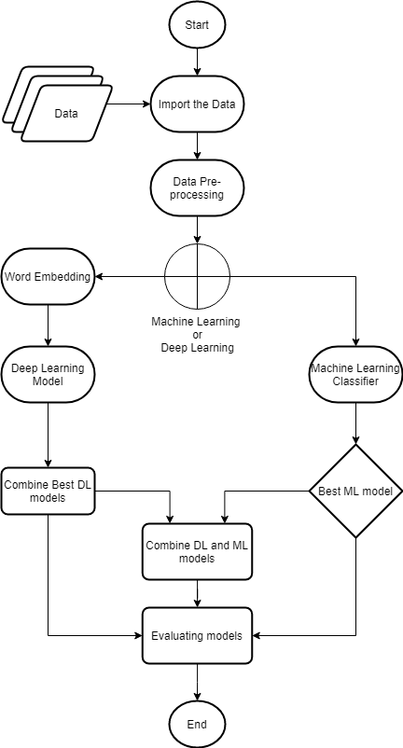
Flowchart

Slide 17
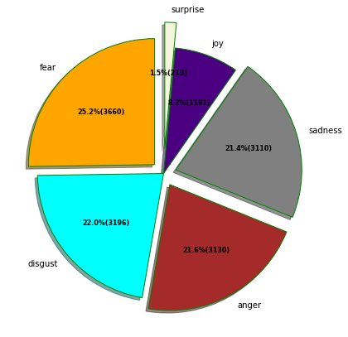
Dataset

Slide 18


Proposed Methodology
(14500)
Datasets
Test - 20%
(2901)
Train - 80%
(11599)

Slide 19
Proposed Methodology
Feature Extraction:
Pre-processing
Emoji Converter
Tokenization
Lemmatization
Stopwords

Slide 20
Proposed Methodology
Word Embedding
Word2Vec – crawl-300d-2M.vec
For Deep Learning
Weighted Words
Term Frequency-Inverse Document Frequency
For Machine Learning

Slide 21

Proposed Methodology
Learning Models:
Machine Learning
Deep Learning
Support Vector Machine(SVM)
Decision Tree(DT)
Random Forest(RF)
Naive Bayes(NB)
Gated Recurrent Unit(GRU)
Bi-directional GRU
Convolution Neural Network(CNN)

Slide 22
Proposed Methodology
Machine Learning approach:
Pipeline( CountVectorizer, TfidfTransformer, ML Classifier)
Fit the model
Predict the Emotion
Compare the predicted Emotion with Test case

Slide 23
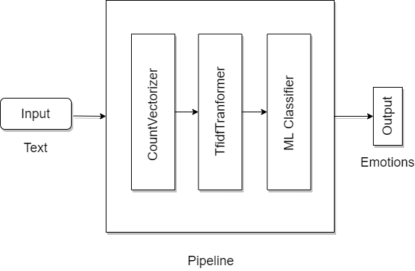

Slide 24
Proposed Methodology
Deep Learning approach
Embedding Layer
Making the DL model
Fit the model
Predict the Emotions

Slide 25
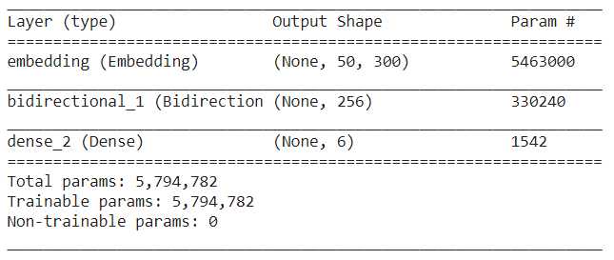
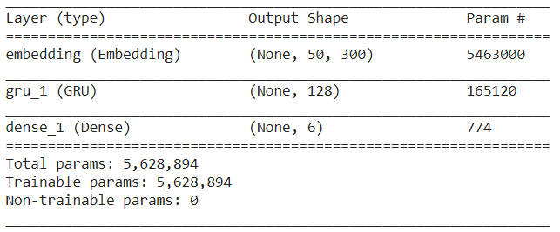
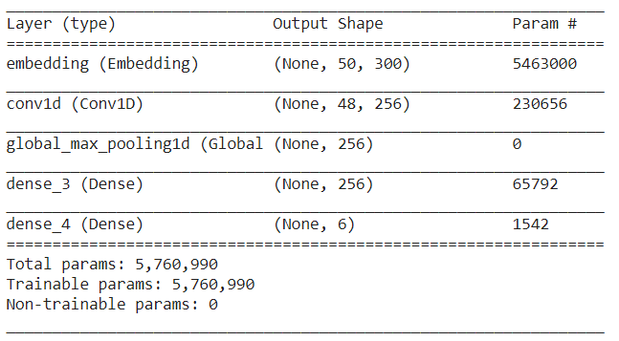
Bidirectional GRU
GRU
CNN

Slide 26
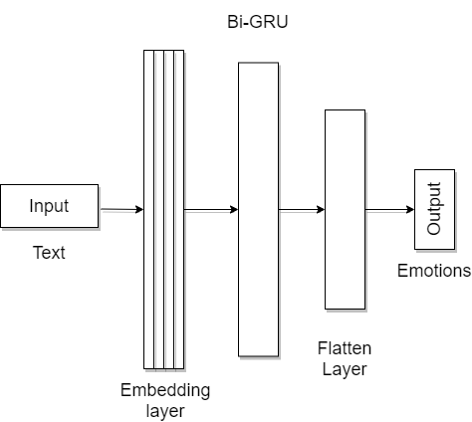
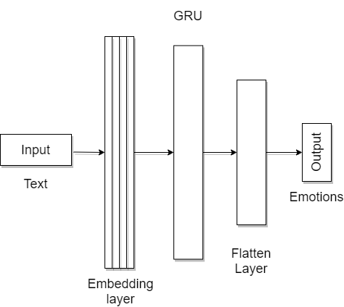
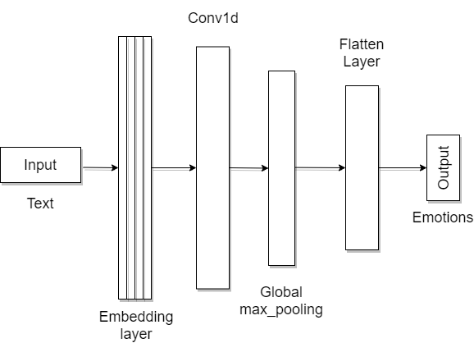
Bi-GRU
GRU
CNN

Slide 27
Proposed Methodology
Hybrid Model
Deep Learning and Machine Learning
CNN + Bi-GRU
SVM
Predict the Emotions

Slide 28
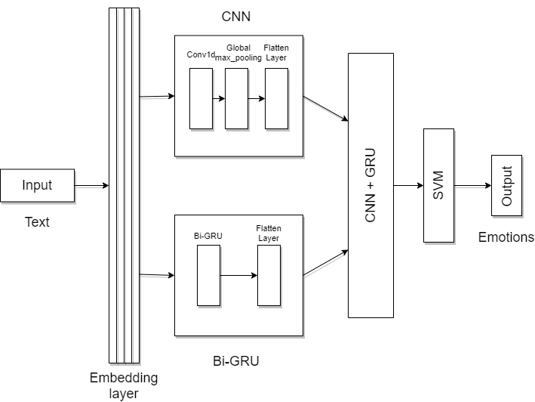

Slide 29
Results
ML Classifier | Precision | Recall | F1-score | Accuracy
SVM | 81.45 | 78.36 | 79.67 | 78.97
RF | 79.42 | 75.66 | 77.02 | 76.25
NB | 61.75 | 51.41 | 49.61 | 68.94
DT | 72.48 | 69.70 | 70.94 | 69.42

Slide 30
Results
Deep Learning | Precision | Recall | F-1 score | Accuracy
GRU | 78.37 | 78.94 | 78.65 | 78.02
Bi-directional GRU | 80.62 | 79.64 | 80.09 | 79.46
CNN | 82.12 | 79.92 | 80.76 | 79.32

Slide 31
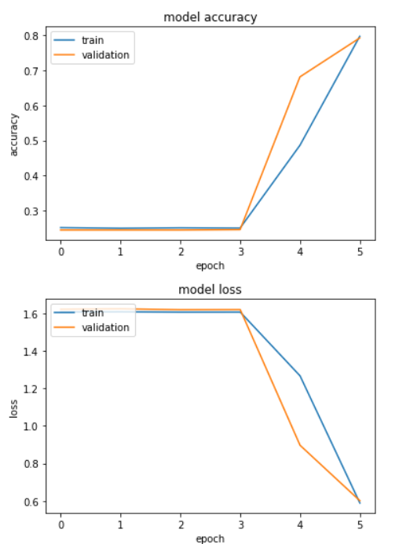
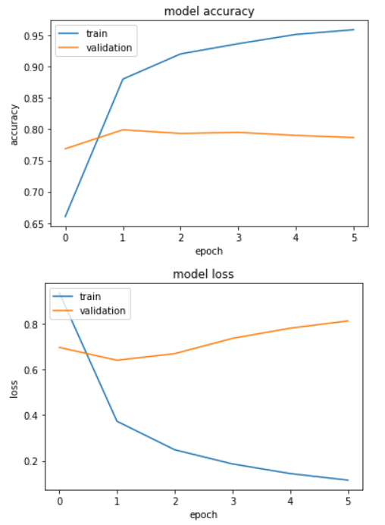
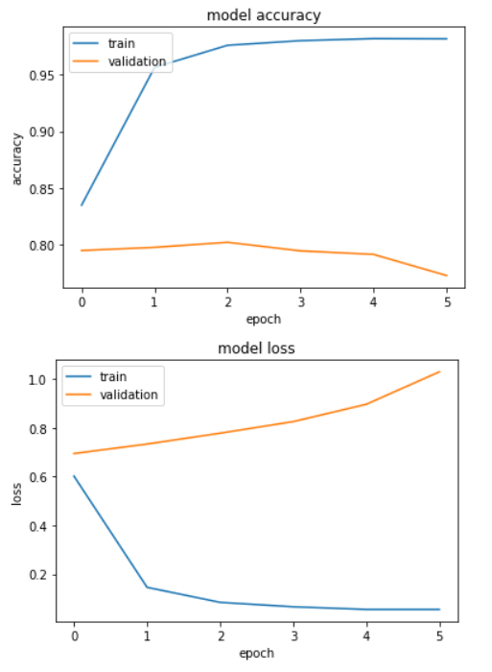
GRU
Bi-GRU
CNN

Slide 32
Results
Combine | Precision | Recall | F-1 score | Accuracy
CNN+Bi-GRU+SVM | 82.39 | 80.40 | 81.27 | 80.11

Slide 33

Conclusion
We have found that emotions not only just depends on the facial expression. But the spoken and textual language plays equal role to find the emotions. Our project is only based on recognizing emotions from Text. We have tried various types of ML and DL approach but our Hybrid model outperforms all other models having 80.11% accuracy. We are detecting 6 types of emotions, they are Anger, Fear, Joy, Sadness, Surprise, and Disgust.

Slide 34
References
Alm CO, Roth D, Sproat R. Emotions from text: machine learning for text-based emotion prediction. InProceedings of human language technology conference and conference on empirical methods in natural language processing 2005 Oct (pp. 579-586).
Bhaskar J, Sruthi K, Nedungadi P. Hybrid approach for emotion classification of audio conversation based on text and speech mining. Procedia Computer Science. 2015 Jan 1;46:635-43.
Shivhare SN, Khethawat S. Emotion detection from text. arXiv preprint arXiv:1205.4944. 2012 May 22.
Seyeditabari A, Tabari N, Zadrozny W. Emotion detection in text: a review. arXiv preprint arXiv:1806.00674. 2018 Jun 2.
Chopade CR. Text based emotion recognition: A survey. International journal of science and research. 2015 Jun;4(6):409-14.
Hajar M. Using YouTube comments for text-based emotion recognition. Procedia Computer Science. 2016 Jan 1;83:292-9.
Hofmann J, Troiano E, Sassenberg K, Klinger R. Appraisal theories for emotion classification in text. arXiv preprint arXiv:2003.14155. 2020 Mar 31.

Slide 35
Thank you

